Slide 1

Ringtones Paid Search
Team 3
Customer Analytics
2022

Slide 2





Table of Contents
01
Context
02
Exploratory Analysis
03
Model Development
04
Conclusion & Recommendations
05
Limitations & Next steps

Slide 3

Context

Slide 4
What is paid search advertisement?
Advertisements generated by search engines based off keyword inputs
Elements:
Headline
Main Body (Line 1 and Line 2)
URL
How it works:
Ad Auctions
Ad rank / position is determined by a number of factors

Slide 5








Key Performance Indicators
Key performance indicators
Predictors
Original variables
Added variables
Click-through Rates
Conversion
Impressions
Clicks
Keyword Combinations:
“ringtone” presence
Keyword count
Time-sensitive
Word Count
Broad vs. Specific
Keyword presence
Headline complexity
Call to Action
Number in headline
Ad Body / Headline:
Revenue
Cost
Profit
Keywords
Action Count
CTR – Click Through Rates
Conversion Rate
Profit

Slide 6


Key objectives of our analysis
Evaluating effectiveness of paid search on:
CTR
Conversion
Profit
Evaluate the impact of competition on CTR, Conversion and Profit:
Make strategic recommendations to increase profit through paid search

Slide 7

Exploratory analysis

Slide 8
Overview of the Data
Keywords
Number of searches
Number of clicks
Number of subscriptions
40
39,925
5,497
292
Searches, Clicks and subscriptions in 20 Days for 40 keywords
Notes:
Walkthrough of the overview of data at an aggregated level
We had around 40 keywords searched over the 20 day period --
40k searches -> 5.5k Clicks -> 292 Subs

Slide 9
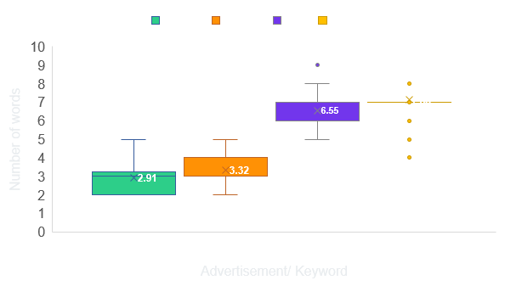
Univariate Analysis
Popular words searched
Avg Position of ads by keyword searched
Word count distribution
25.12% of the Headlines of ads are specific
Notes:
Analysis: 1) Univariate 2) Bivariate
keyword related attributes:
words that people most often search
word count distribution: Readability of advertisement and optimal number of keywords to bid on
Avg position of ads by keywords searched – keywords more successful in showing relevant ads - lower number means top to appear, and vice versa
For example, the advertisements that bid on ringtones adults can't hear is more likely to come on the top position

Slide 10
Univariate Analysis
Top 5 keywords by avg level of competition
Top 3 Most subscribed Ads
Headline | # of Keywords | # of Subscriptions | Net Profit
Get 24 CTU Ringtones | 23 | 186 | $320.18
Stealth Mosquito Ringtone | 5 | 34 | -$10.84
TV Theme Ringtones | 1 | 10 | -$59.36
$167.73 - Avg cost of the advertisement
$182.2 – Avg revenue of the advertisement
Top 3 Most Profitable Ads
Headline | # of Keywords | # of Subscriptions | Net Profit
Get 24 CTU Ringtones | 23 | 186 | $320.18
System Of A Down Tones | 1 | 7 | $66.73
Get Buckcherry Ringtones | 1 | 5 | $34.18
$14.46 – Avg profit from the advertisement
45% - Advertisements were profitable
Notes:
4. Keyword by average level of competition along with the level of volume or traffic they bring in. Most of the top 5 competitive keywords not bringing much traffic – Do not bid on this keyword
5. Next we look at Most subscribed ads with no of the keywords they bid in, no of subs and profit they bring in. > Line by line -- analysis on if they are bidding it right
6. Overview stats

Slide 11
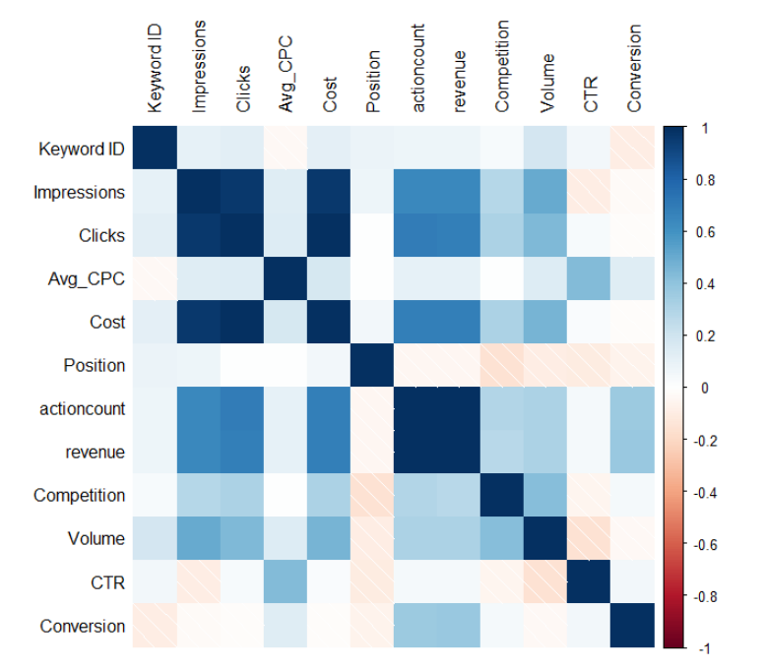
Bivariate Analysis
Impressions highly correlated with Clicks and Cost
Conversion highly correlated with Revenue
Volume slightly correlated with Competition, Impressions, Clicks and Cost
Position slightly negatively correlated with volume and competition
Notes:
Correlation between all the metrics

Slide 12

Model Development

Slide 13

Variable selection
List of all available independent variables
Selection criteria:
Make business sense
Informative
Actionable (directly guide management decisions)
Relevant and significant (small p-value)
Not highly correlated with each other
Data availability
Log transformation
Added variables
“ringtone” in keyword
Keyword word count
Ad word count
Number in headline
Headline complexity
Keyword presence in headline
Broad vs. Specific headline
Call to action in ad body
Time-related element in ad body
Keyword presence in ad body
Selected variables for the model

Slide 14



Model selection (linear & logistic regression)
Criteria
Metrics
Small p-value for overall model and individual independent variables
High R2
Model fit
Accuracy on test set
Good performance on the test set (high out-of-sample R2)
Reasonable number of variables used
Easy to track and monitor over time
Ease of implementation

Slide 15
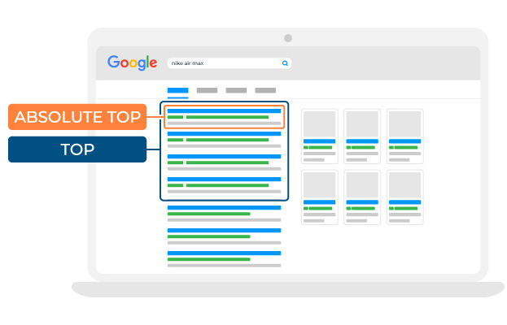

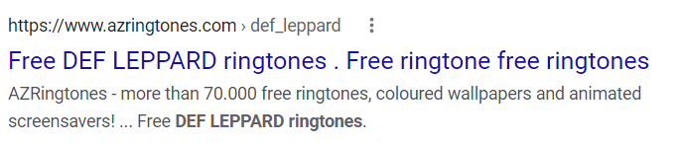


Impact on Click-Through-Rate (CTR)
Attributes
Significant variables
Impact
Level of competition
Competition
Position (smaller, better)
Word count
Complexity (readability)
Ad
Time-related (sense of urgency)

Slide 16




Model 1 - Click-Through-Rate (CTR)
Variables​ | Coefficients​ | P-Values​
Headline Complexity | -0.0822​ | 7.65e-06 ***
Ad Line1 Urgency | 0.1368 | 0.00011 ***
Headline Wordcount | 0.0308 | 0.00593 **
Ad Line1 Wordcount​ | 0.0280 | 0.00128 **
Ad Line2 Wordcount​ | 0.0348 | 0.00149 **
Volume | -0.0372 | 0.00670 **
Competition | -0.0839 | 0.00852 **
Position (log) | -0.0446 | 0.00128 **

Slide 17
Impact on Conversion
Attributes
Significant variables
Impact
Number in Headline
Ad
Keyword in Headline
Keyword
Headline
Conversion
Buckcherry Ringtones
Get Buckcherry Ringtones
2.99
Gospel Ringtones
Keyword: Inspirational Ringtones
1.70
24 CTU Ringtones
Get 24 CTU Ringtones
1.32

Slide 18
Model 2 - Conversion
Variables​ | Coefficients​ | P-Values​
Number in Headline | -0.04323 | 0.009864 **
Keyword in Headline​ | 0.05315 | 0.048090 *

Slide 19
Impact on Profit
Attributes
Significant variables
Impact
Level of competition
Competition
Position (smaller, better)
Ad
Number in Headline

Slide 20
Model 3 - Profit
Variables​ | Coefficients​ | P-Values​
Competition | 5.3397 | 0.00676 *
Number in headline | 1.4942 | 0.08695 (.)
Position (log) | -1.5539 | 0.1005 (.)
(.) at 10% significance level

Slide 21

Conclusion & Recommendations

Slide 22

Assessment of paid search performance
Performance over 20 days
55% keywords are profitable
55% ad headlines are profitable

Slide 23
Assessment of paid search performance
Most profitable keywords
Least profitable keywords

Slide 24
Assessment of paid search performance
Most profitable headlines
Least profitable headlines

Slide 25
Recommended paid search strategies
Improve keyword bidding strategies
Optimize ad copy
Address competition
Bid for keywords that are consistent with the ads
Monitor the performance of most/ least profitable keywords and revise the bids accordingly
Informative headline and body
Use simple and easy-to-understand text
Show urgency in ad body and numbers in headline
Improve landing page to increase customer experience and increase conversion
Provide differentiated offers and promotions to stand out from competitors
Notes:
Bidding on higher competition keywords

Slide 26

Limitations & Next Steps

Slide 27




Limitations and next steps
Limitations
Next steps
Limited Keywords (40 total)
Short Time-Period (20 days)
Missing data on factors that can affect conversion (e.g., website, landing page, URL performance)
Small dataset (800 total observations)
Collect more data for:
Landing pages
Different time periods
More keyword combinations
Try other models to predict CTR, conversion, and profit
Explore lagged effects of paid search

Slide 28
Thank You!

